Slide 1
Immutable JS

Slide 2
Immutable JS
Immutable data encourages pure functions
(data-in, data-out) and lends itself to much simpler application development and enabling techniques from functional programming such as lazy evaluation.
// ES6
foo.map(x => x * x);
// ES5
foo.map(function (x) { return x * x; });

Slide 3
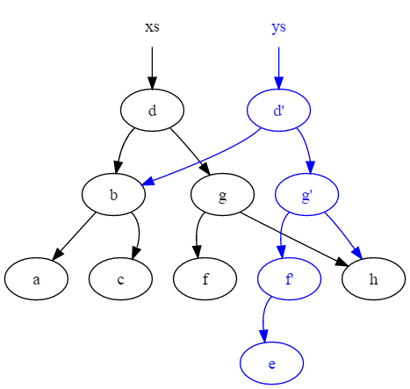
Immutable JS
Mutations are in-place changes to data or the data structures that contain it.
Immutability makes a copy of such data and data structures whenever a change is required. (New version is created)

Slide 4
Immutable JS
Array.map applies a function to each item in an array and returns a new array, without modifying the original in the process.
Functional programming favors functions that can be passed to algorithms returning new versions of existing data.
(eg. Array.map)
"Immutable data structures go hand-in-hand with side-effect free functions

Slide 5
Immutable JS
Immutability
Immutability refers to the way data (and the data structures managing it) behave after being instanced: no mutations are allowed.
Mutations can be split in two groups:
visible mutations
invisible mutations.
Visible mutations are those that either modify the data or the data structure that contains it in a way that can be noted by outside observers through the API.

Slide 6
Immutable JS
Invisible mutations are changes that cannot be noted through the API (e.g caching data structures ).
Invisible mutations can be considered as side-effects
var list1 = Immutable.List.of(1, 2);
//We need to capture the result through the return value:
// list1 is not modified!
var list2 = list1.push(3, 4, 5);

Slide 7
Immutable JS
Benefits of Immutability:
Locking for multithreading is no longer a problem: as data cannot change, no locks are needed to synchronize multiple threads.
Persistence becomes easier.
Copying becomes a constant-time operation: copying is simply a matter of creating a new reference to the existing instance of a data structure.
Value comparisons can be optimized in certain cases: deep value comparisons can become reference comparisons.

Slide 8
Immutable JS
Strings in JavaScript are immutable.
All methods in the String prototype perform either read operations or return new strings.
A call to Object.freeze marks all properties as immutable. (Shallow)
Assignments will either silently fail or throw an exception.
If you are writing an immutable object, calling Object.freeze after construction can help.

Slide 9
Immutable JS
PURITY
Purity is an additional condition that may be imposed on functions:
pure functions rely only on what is explicitly passed to them as arguments to produce a result.
Pure functions must not rely on global state or state accessible through other constructs.
var globalValue = 99;
// This function is impure: its result will change if globalValue is changed, even when passed the same values in 'a' and 'b'
function sum(a, b) {
return a + b + globalValue;
}

Slide 10
Immutable JS
Persistence
Persistence, in the context of data structures, refers to the possibility of keeping older versions of a data structure after a new version is constructed.
Performing a full copy of the whole data structure is therefore suboptimal.
Immutable data structure algorithms, taking advantage of the immutability of the first version of the data, perform copies of only the data (and the parts of the data structure) that need to change.

Slide 11
Immutable JS
Partially persistent data structures are those which support modifications on its newest version and read-only operations on all previous versions of the data.
Fully persistent data structures allow reading and writing on all versions of the data. Writing or modifying data implies creating a new version of the data structure.
var list1 = Immutable.List.of(1, 2);
var list2 = list1.push(3, 4, 5);
var list3 = list1.concat(list2, list2);

Slide 12
Immutable JS
Lazy evaluation
Lazy operations are those that do not perform any work until the results of those operations are required
Immutable data helps because lazy operations can be constructed being certain data will not change.
var oddSquares = Immutable.Seq.of(1,2,3,4,5,6,7,8)
.filter(x => x % 2)
.map(x => x * x);
// Only performs as much work as necessary to get the first result console.log(oddSquares.get(1)); // 9

Slide 13
Immutable JS
Composition
Composition in the context of functional programming refers to the possibility of combining different functions into new powerful functions.
First-class functions (functions that can be treated as data and passed to other functions), closures and currying (think of Function.bind ) are the tools necessary for this.
Immutable.Range(1, Infinity)
.skip(1000)
.map(n => -n)
.filter(n => n % 2 === 0)
.take(2)
.reduce((r, n) => r * n, 1);

Slide 14
Immutable JS
Immutable.js data structures
List,
Stack,
Map,
OrderedMap,
Set,
OrderedSet,
Record,
lazy Seq.

Slide 15
Immutable JS
List: a List is an immutable representation of a JavaScript array.
The usual array operations are available with the twist that their return value is a new immutable object whenever the content of the original object is changed.
Demo: list.js

Slide 16
Immutable JS
Stack: first in, last out data structure, defined with the usual operations.
The serialized equivalent of a stack is an array, where the element with index 0 corresponds to the element to be popped.
All elements of the stack can be accessed without popping via the get method.
For modifying the stack use push and pop.
Demo : stack.js

Slide 17
Immutable JS
Map: we have already seen the Map data structure in action. It is the immutable.js representation of a JavaScript object.
OrderedMap: an ordered map is a mixture of objects and arrays. It can be treated as an object with the feature that its keys are ordered based on the order in which they were added to the map. Modifying the value belonging to an already added key does not result in a change of the order of keys.
The order of the keys can be re-defined using the sort or sortBy methods, returning a new immutable ordered map.

Slide 18
Immutable JS
Set:
A Set contains an array of unique elements. All usual operations are available.
In theory, the order of elements in the set should not matter.

Slide 19
Immutable JS
Record:
a record is like a JavaScript class with default values for some keys.
When instantiating a record, the values for the keys defined in the record can be given during instantiation.
In absence of a value, the default value of the record is used.
Demo : Record.js

Slide 20
Immutable JS
Seq: sequences are lazy finite or infinite data structures.
Elements of a Seq are only evaluated on demand. Depending on the type of sequence, we can talk about a KeyedSeq, an IndexedSeq or a SetSeq.
Finite and infinite sequences can be defined using
Immutable.Range(),
Immutable.Repeat(),
a mutation of a seq using a functional utility such as map, filter.

